Slide 1
CHym performance under different regions
A. Martinez
O. Garcia
Y. Mahmoud
Fourth Workshop on Water Resources in Developing Countries: Hydroclimate Modeling and Analysis Tools | (smr 3125) –
ICTP (12-23 June. 2017)

Slide 2
Study Objectives
Test the CHym model performance with different datasets in humid and arid regions
Identify the typical simulated values and seasonal behavior
Look at the response of the simulated discharge and different ENSO phases

Slide 3
Case (1): Tropical South America

Slide 4
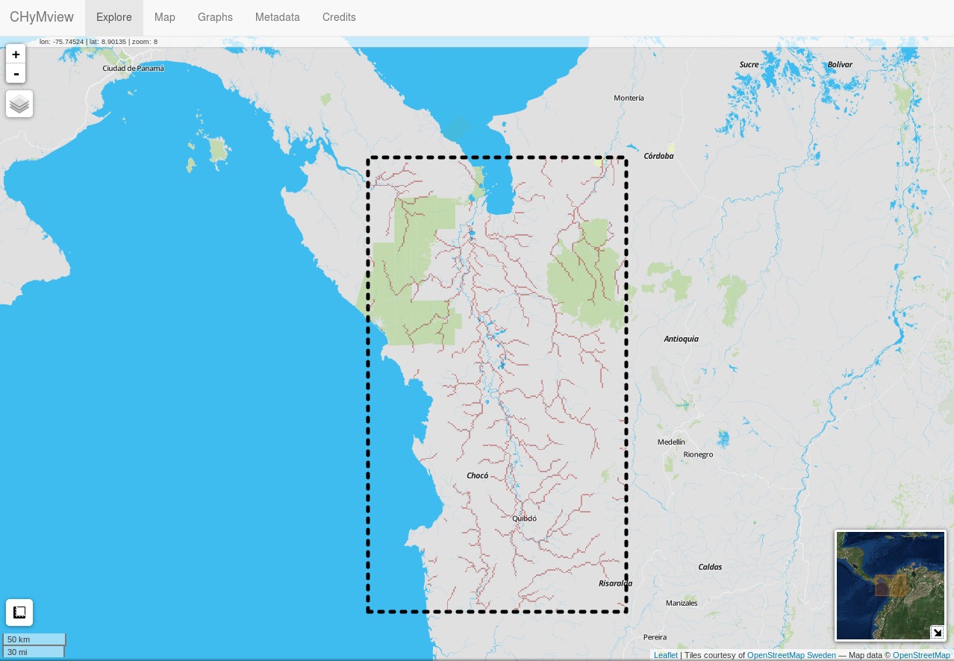
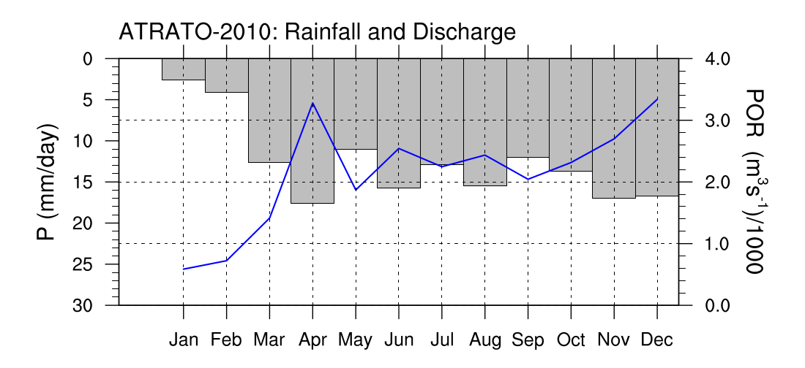
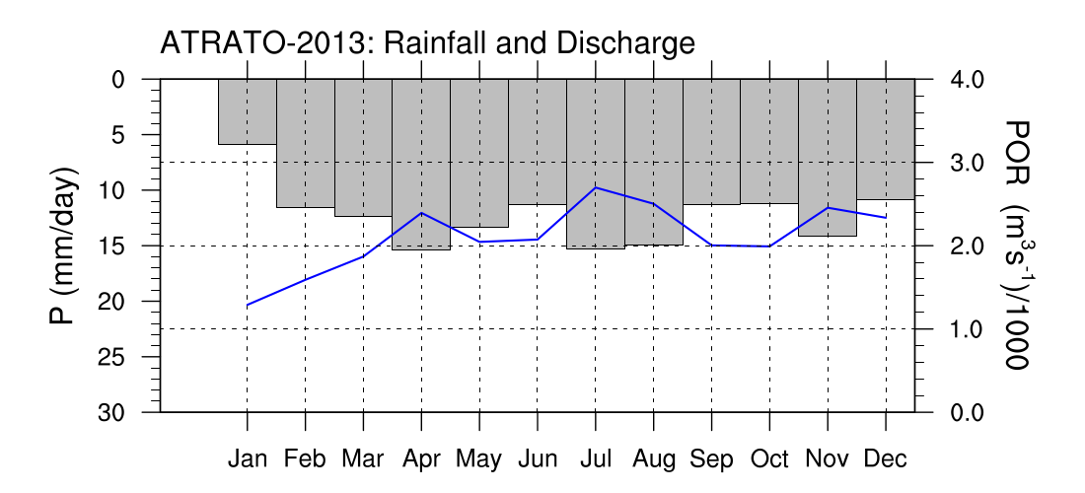
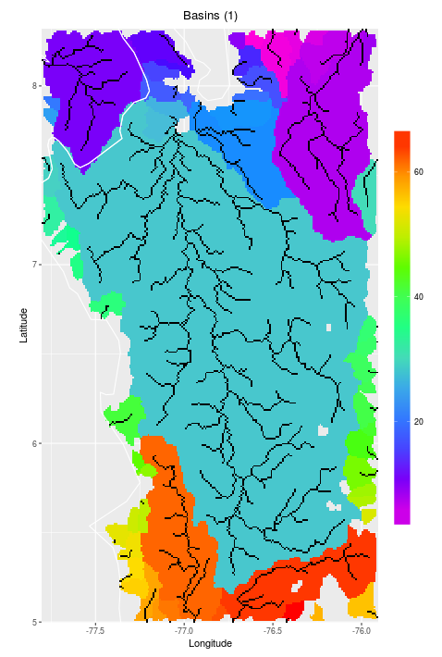
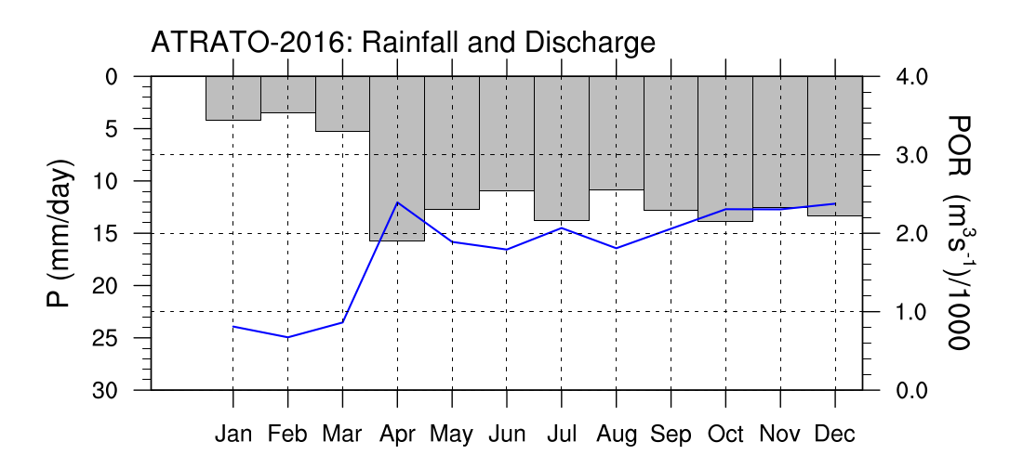
Atrato River:
Country: Colombia
Area : ~ 38000 km².
Length: ~ 750 km.
In one of the rainiest places in the Americas.
CHyM:
Area : 34147.2 km².
DEM: NASA

Slide 5
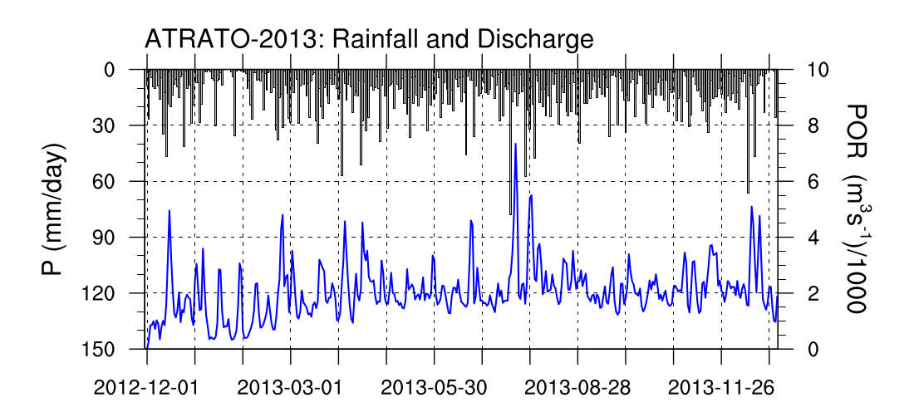
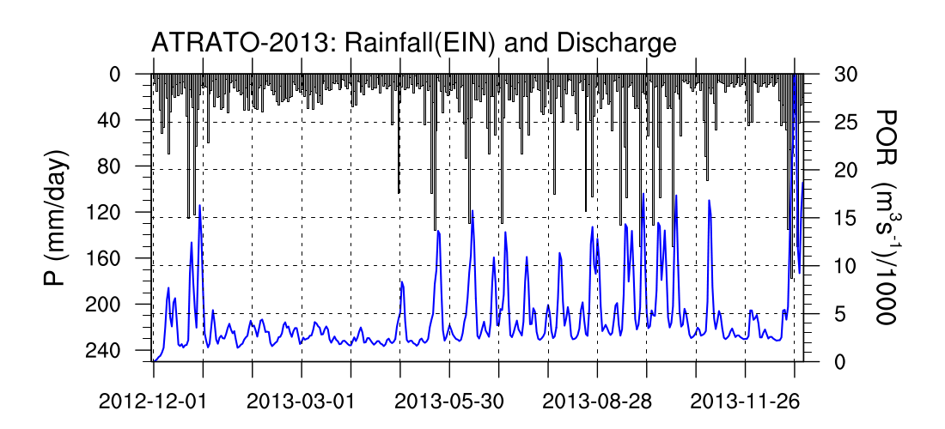
Rainfall: TRMM
Precipitation rarely exceeds 60 mm/day.
Discharge peaks exceed 4000 m³/s.
Notice the differences in the axes!
Rainfall: ERAIN
Precipitation can exceed 80 mm/day.
Discharge can be as high as 30000 m³/s !.

Slide 6
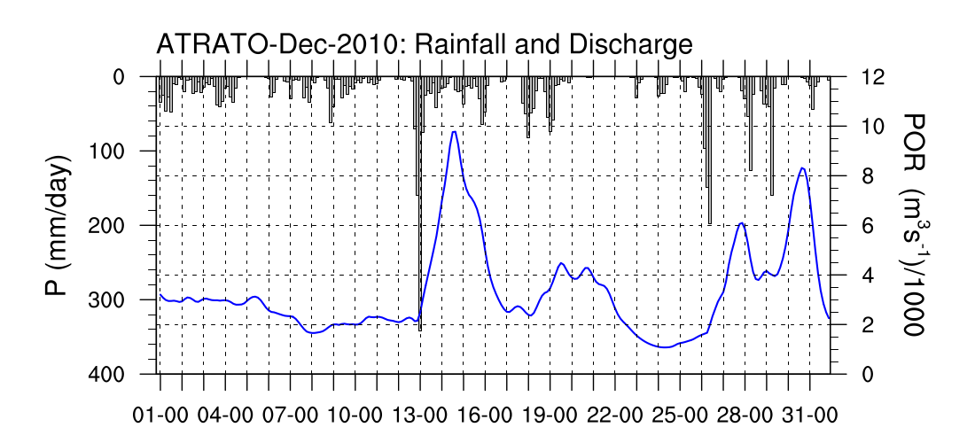
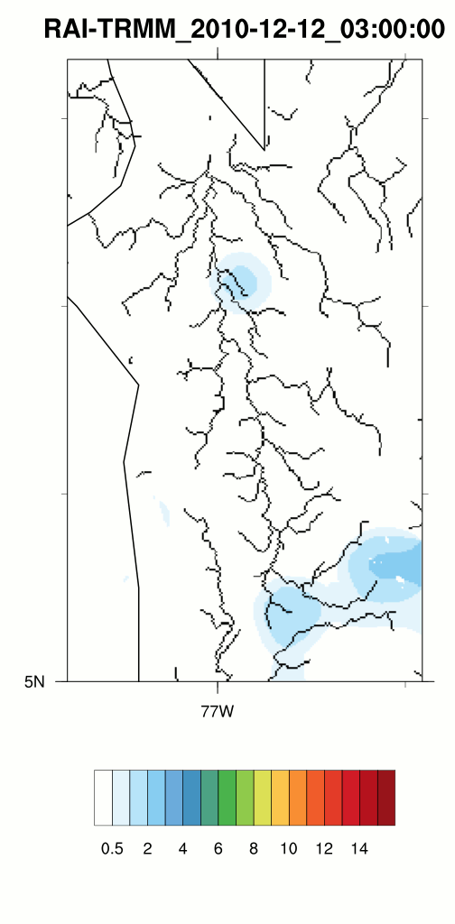
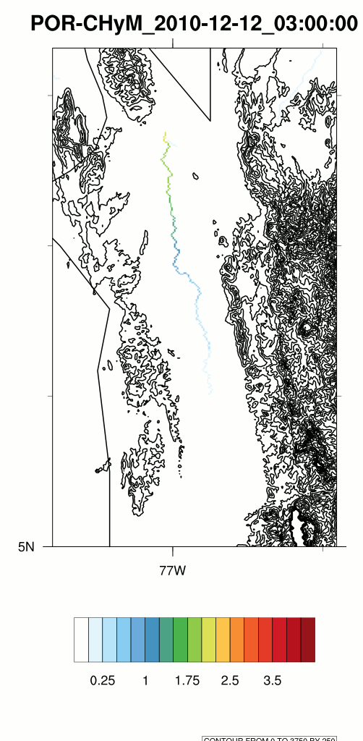
Precipitation event started around 18UTC on the 12th.
Peak precipitation at 00UTC on the 13th.
Peak discharge at 12UTC on the 14th (~ 36 hours after peak precip.).

Slide 7
Case (2): Central America

Slide 8
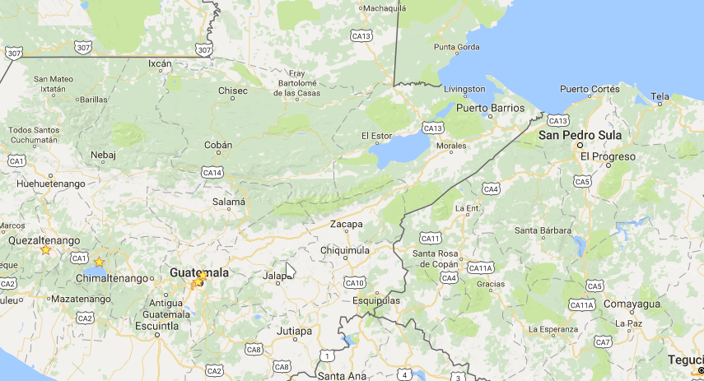
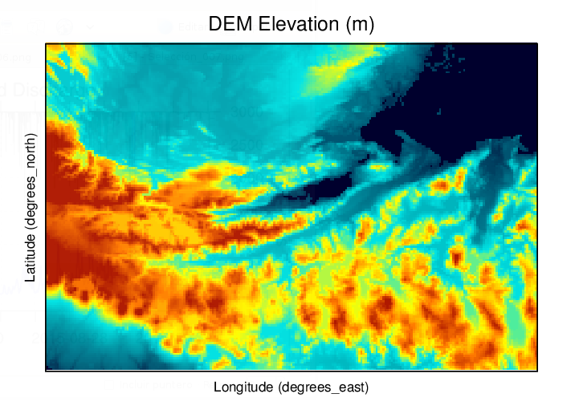
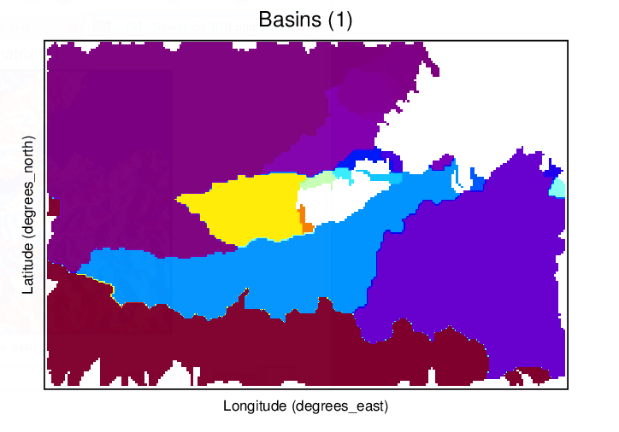
Motagua Basin (Guatemala)
Actual area 15 132 km2
CHyM calculated area 15 369 km2
Domain: Central America
-91.50, 14.00 to -87.47, 16.68
250 x 150 cells (435 x 298.2 km2)
Resolution 0.018 deg (1971 m)
Years Simulated:
2000(strong La Niña)
2013 (Neutral)
2015(strong El Niño)
Data Sources:
HydroSheeds DEM
TRMM Precipitation
ERA dataset Temperatures
Spin-up time of 1 month
Default values for cpar!

Slide 9
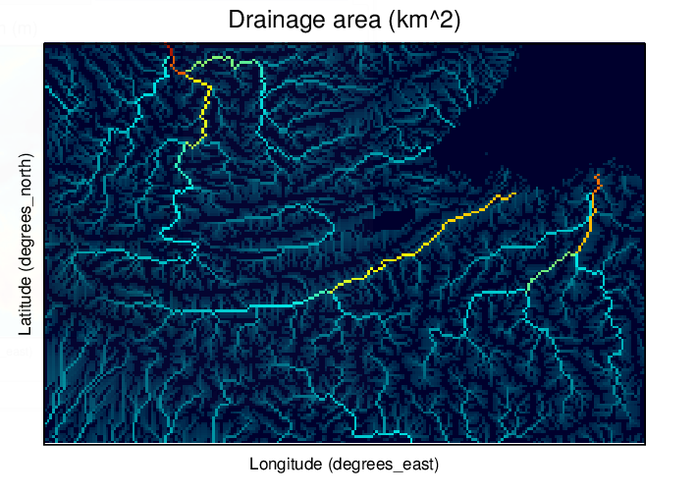
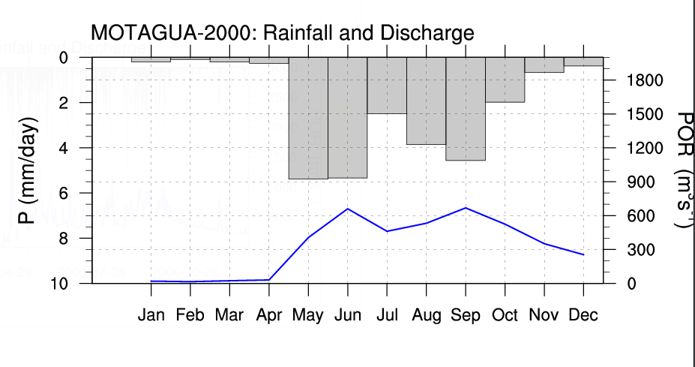
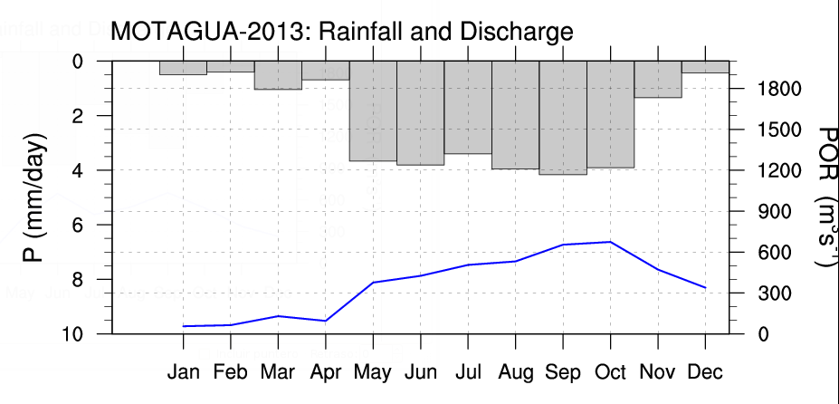
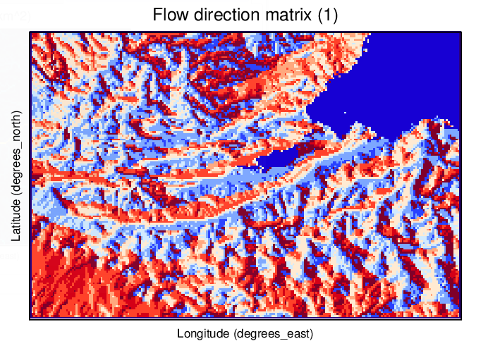
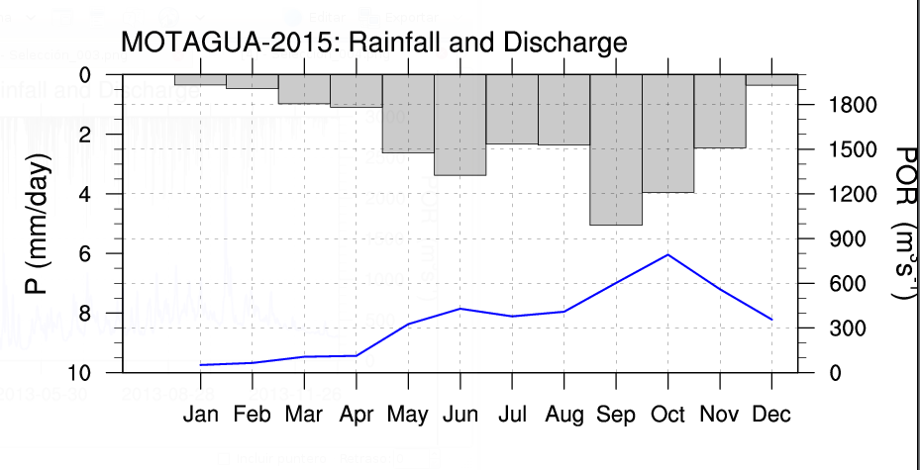

Slide 10
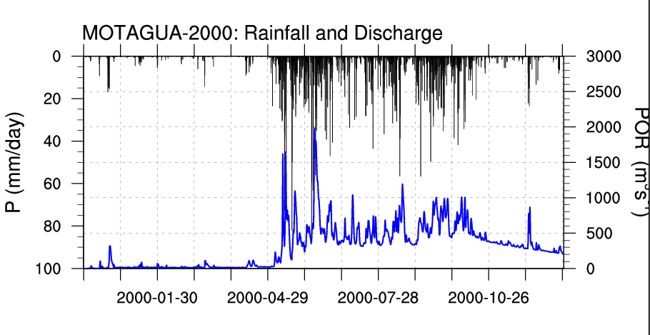
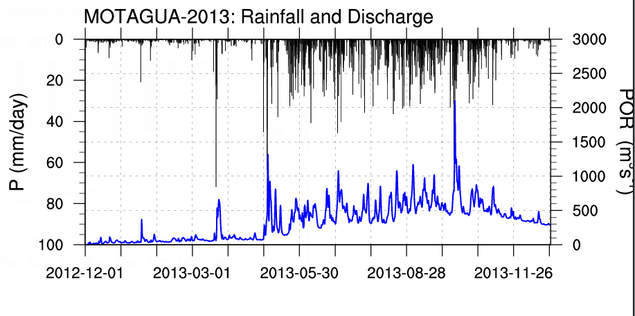
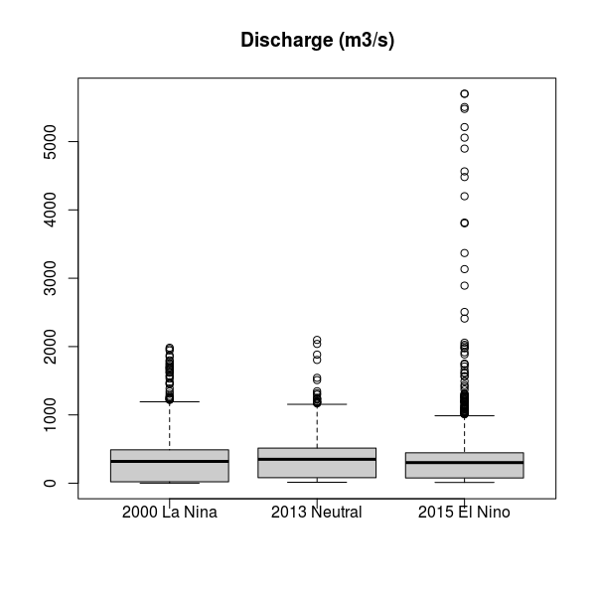
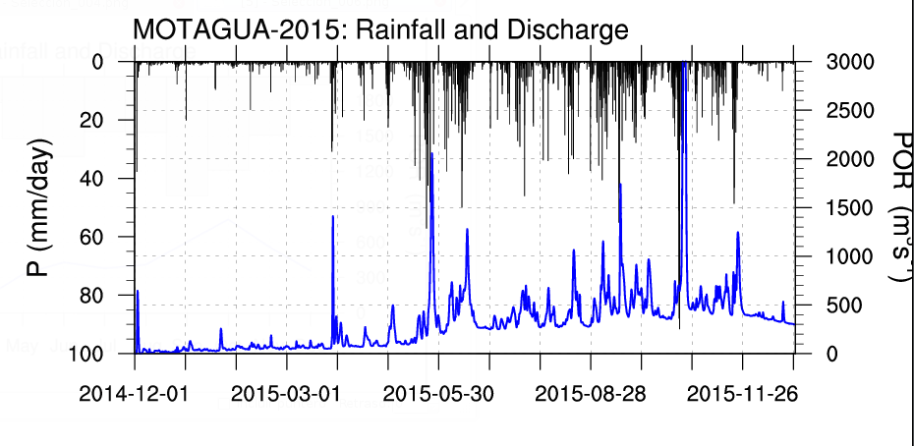
The differences between years are clear when the daily discharges are compared.

Slide 11
Case (3): Egypt - Flood 2010

Slide 12
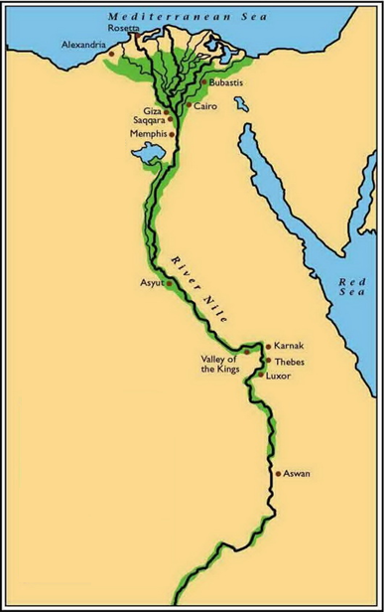
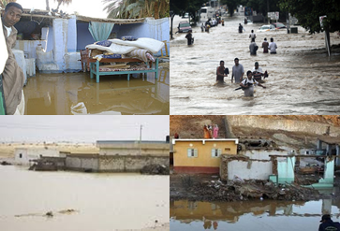
The experiment tests the CHym hydrology model over Egypt as an Semi arid/Arid region with observation (ERA-Interim) and climate model Simulation (RegCM output)
Nlon = 800
Nlat = 1200
Slat = 28.4
Slon = 22.0
Dij = 0.0009
Demf = Nasa
Chym_sdate= 2009010100 to 2011010100
Chym_dsource = ‘EIN75’ & ‘AFR44-MPI-rcp8.5’
Chym Setting
Area: 1,010,407.87 km2
Climate Classification : Dry climate
Annual Prec. : 250-350 mm/year

Slide 13
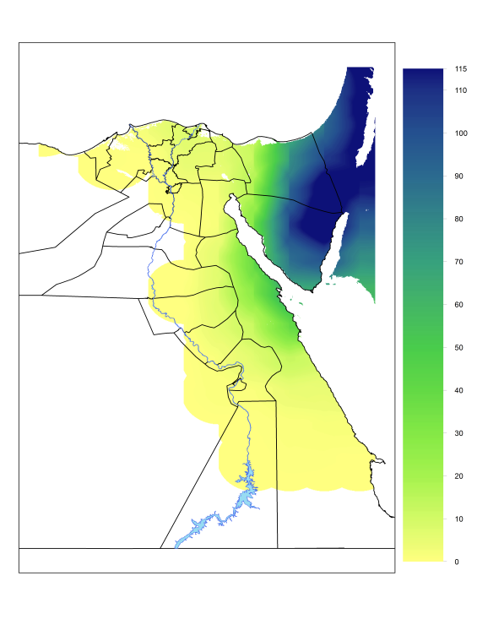
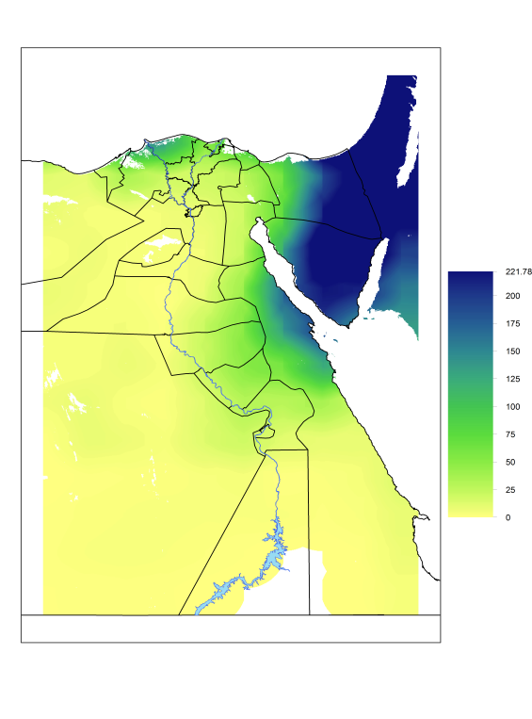
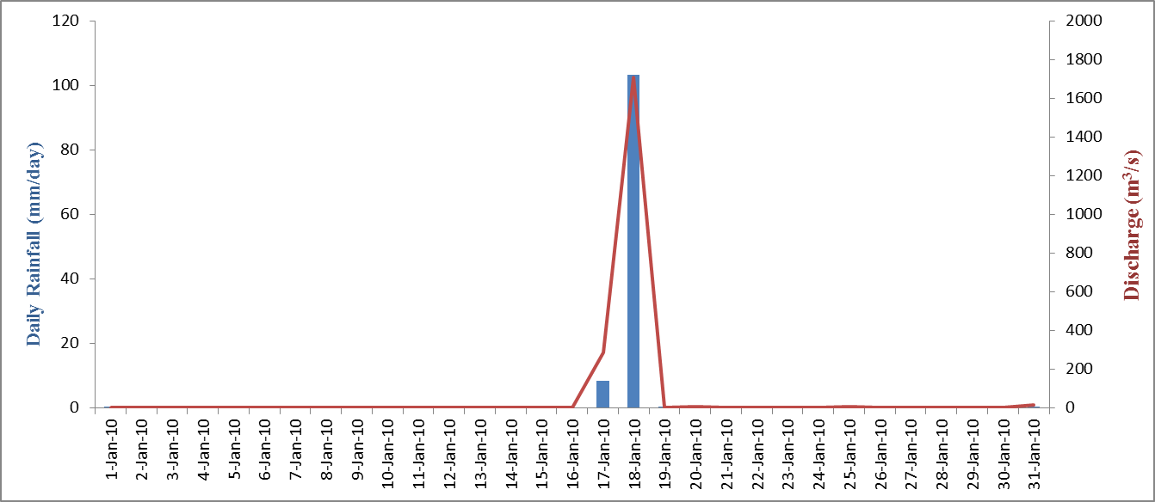
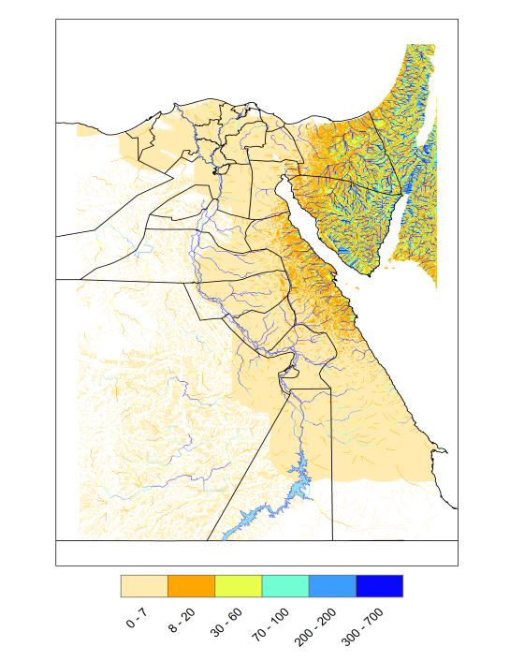
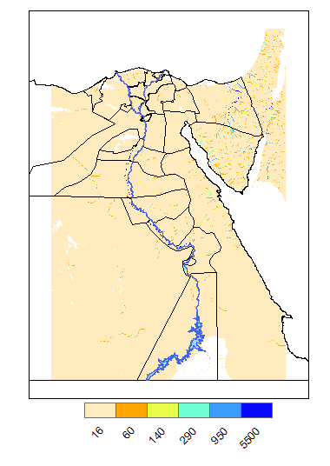
ERA-Interim Results
Rainfall 18 Jan.2010
Total Rainfall in Jan.
Discharge 18 Jan.2010
Discharge in Jan.

Slide 14
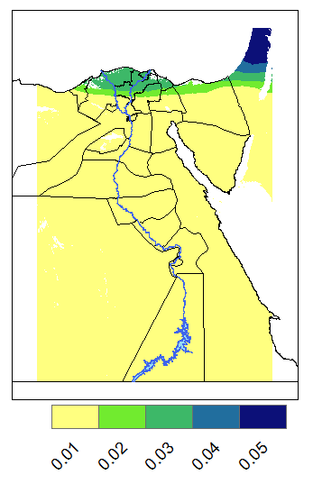
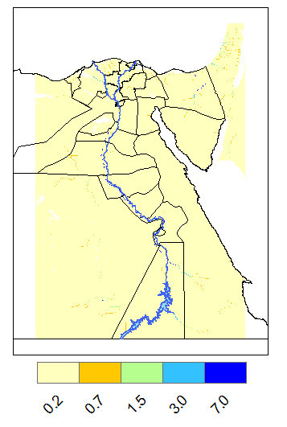
RegCM (MPI-ESM-MR of rcp8.5) Results
Rainfall Jan.2010
Discharge Jan.2010

Slide 15
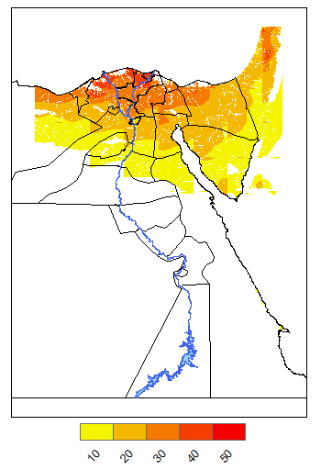
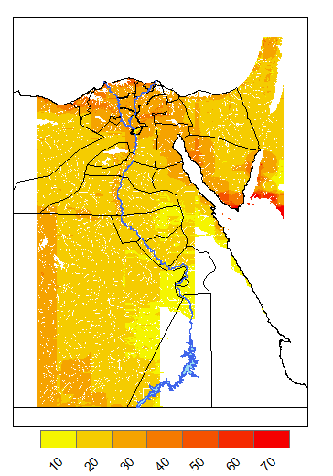
Cont. RegCM Results
Evap. Jan.2010 of ERA
Evap. Jan.2010 of RegCM

Slide 16
Thank you for your attention

