Slide 1
Integration of Eco-hydrological Process in Heihe River Basin
Research Programme of National Natural Science Foundation of China(2011-2018)
Xiong Zhe Tian Zhan, Sun shanlei
Institute of Atmospheric Physics (IAP), Chinese Academy of Sciences (CAS)

Slide 2
outline
Introduce Integration of Eco-hydrological Process in Heihe River Basin
Dynamic downscaling by high resolution Regional Integrated Environmental Model System ( RIEMS) in Heihe River Basin
Preliminary result simulated by Chymodel in HRB

Slide 6
Simulation of high resolution of future climate change scenarios and assessment of uncertainty in the HRB
Budget: 4 millions RMB
Period: 2015-2018

Slide 7
Distribution of meteorological and hydrological observation in the HRB
Meteorology: 14，hydrology: 13，time period：1990-2010

Slide 8
A Schematic Diagram of high resolution RIEMS For HRB
Improved Lateral Boundary Condition
Exponential relaxation method
Spectral nudging technique
U,V,W,Precipitation,Cloud
Global analysis or GCMs outputs
POM
Lateral Boundary Scheme
MM5v3
Heating Rate
Radiation Flux
U, V
T
,Rh
Atmospheric chemistry/ particle model
Rh
Radiation
Lai
npp
T
Cloud
Moisture
Package
Two way interaction between climate and biosphere
Scheme
(CCM3)
(O3, CO2, sulphate, black carbon, dust aerosol, etc)
P , Cloud
Soil moisture
Initialization scheme
BATS
(
AVIM)
Surface
Radiation Flux
A hydrological model
Zeng ocean flux
BIOME 3
Land use model
Emission model

Slide 9
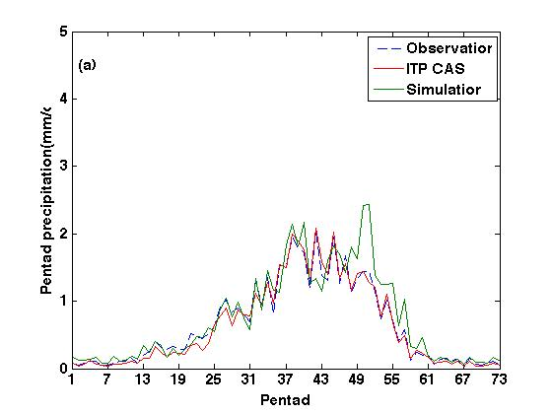
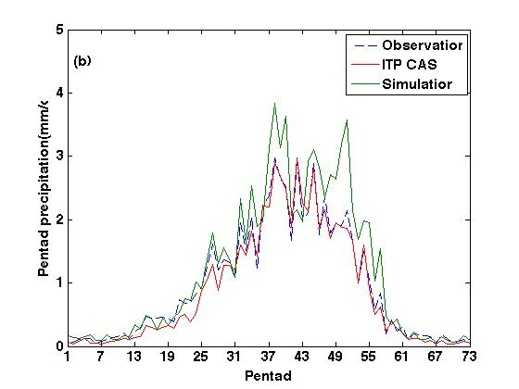
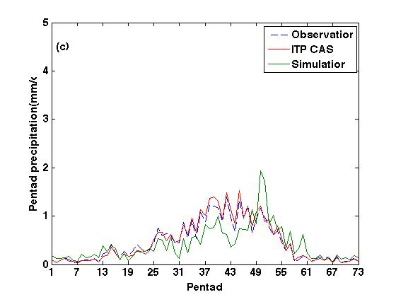
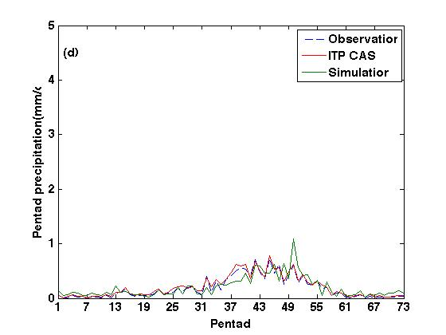
Time series of pentad precipitation in different regions
The whole domain R=0.93
upper stream R=0.95
Middle stream R=0.74
Low stream R=0.80
Notes:
Observation 为观测站点数据，itp cas 为青藏所卫星遥感数据，simulation 为区域气候模式模拟的结果
（1）对于整个黑河流域来说，区域气候模式模拟能够较好模拟出观测候随时间的演变，并且与观测相关系数为0.93，通过99%置信度检验
（2）对于黑河流域来说，降水主要来源于上游地区占黑河流域降水70-80%，中游降水次之，降水最少地区为下游地区
（3）对于上中下游地区候降水来说，区域气候模式模拟的候降水强度与观测非常接近，能够较好模拟出候降水随时间演变，并与观测相关系数分别为0.95，0.74，0.80，都通过99%置信度检验

Slide 10
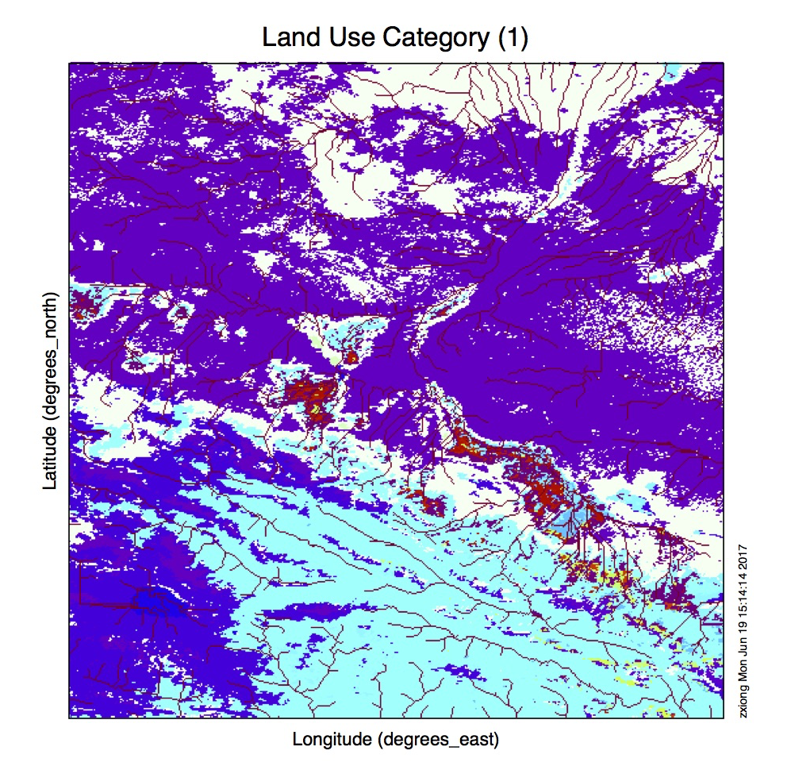
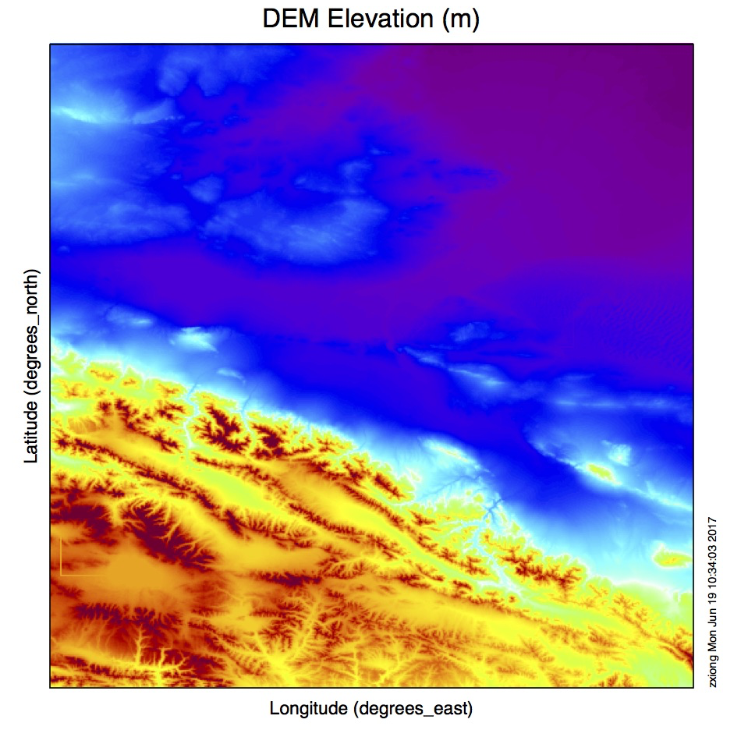
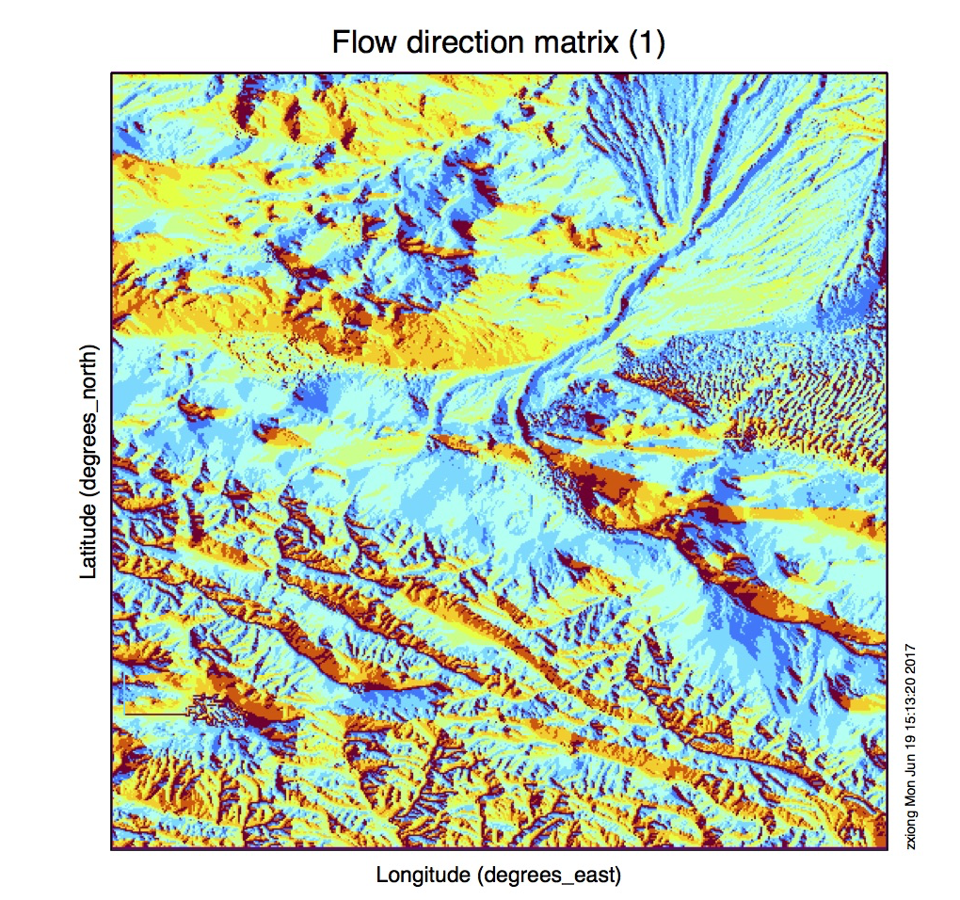
Static field in ChyModel
Input data: TRMM
periold:2010-01-2010-12

Slide 11
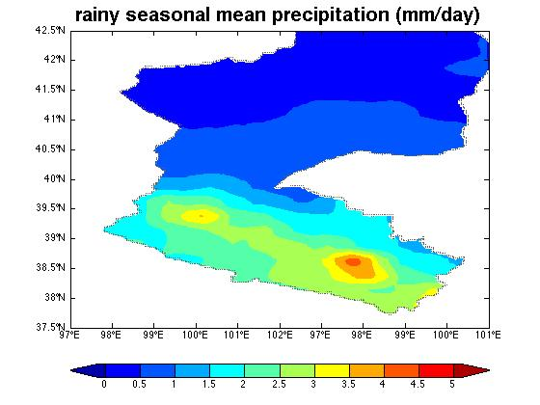
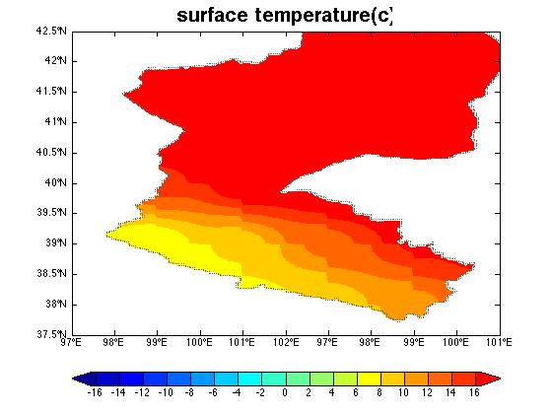
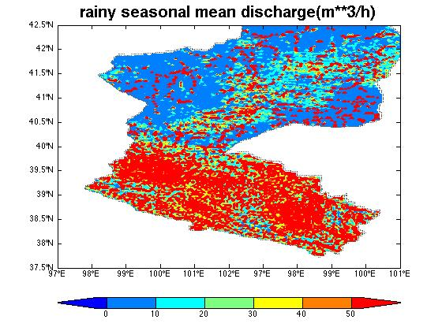
Rainy seasonal mean precipitation,
temperature
discharge
(May-Sept.)

