Slide 1
Modeling hydrological system of the Mono River basin (West Africa) using the distributed CHyM model
Hèou Maléki BADJANA (Togo)
Jean HOUNKPE (Benin)
Rinelle DJIONDO NGONGANG (Cameroun)
Cosmo NGONGONDO (Malawi)
Fourth Workshop on Water Resources in Developing Countries: Hydroclimate
Modelling and Analysis Tools
12-23 June 2017, Trieste, Italy

Slide 2
Outline
Introduction
Presentation of the study area
Methodology
Results
Conclusion

Slide 3
Introduction
Understanding and modeling hydrological systems of river basins is essential for sustainable water resources management
Advantage of physically-based distributed hydrological models
Few studies on hydrological modeling in West Africa
Objective: assess the performance of CHyM model in simulating the hydrological system of Mono River basin (West Africa)

Slide 4
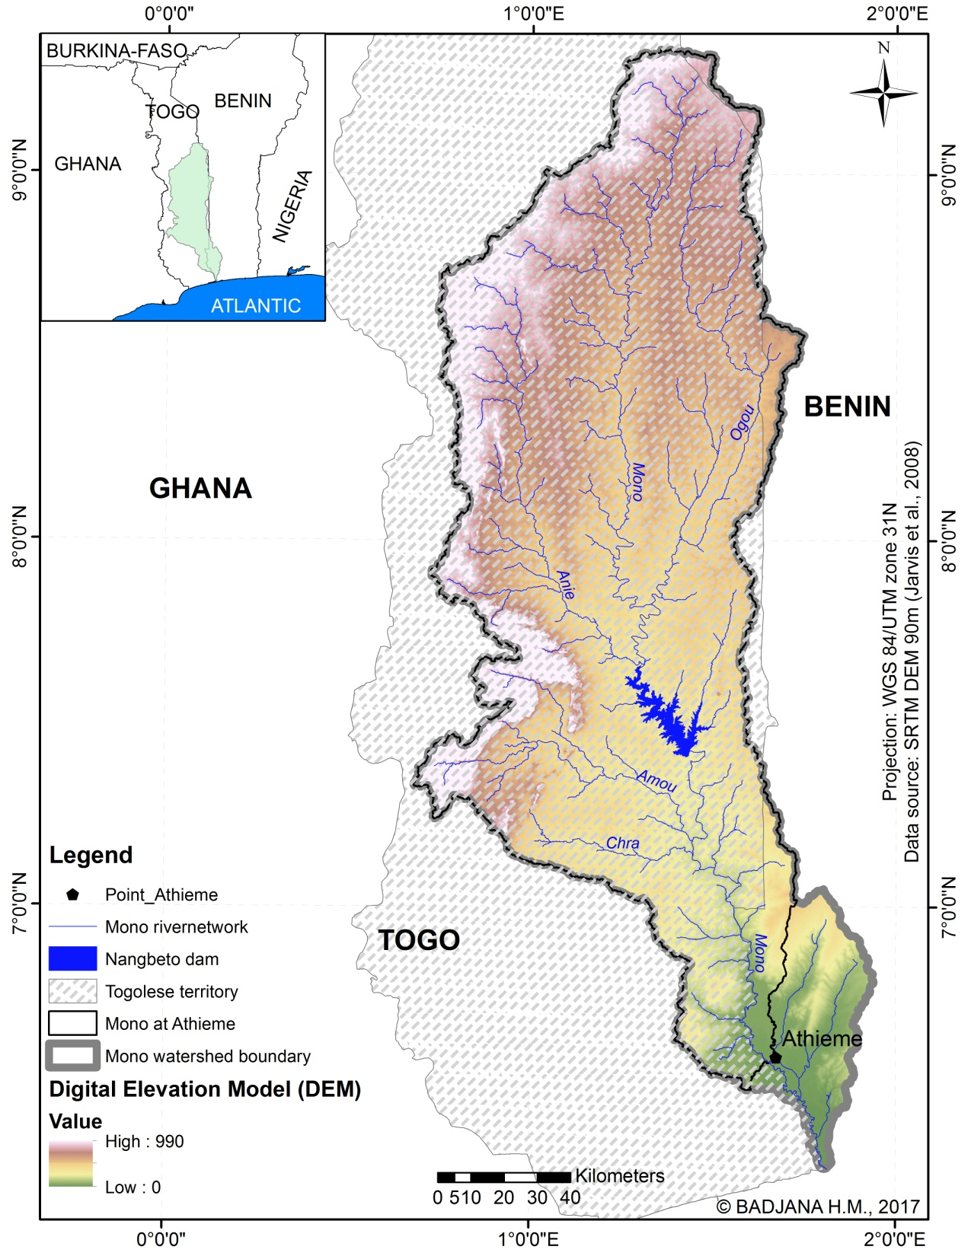
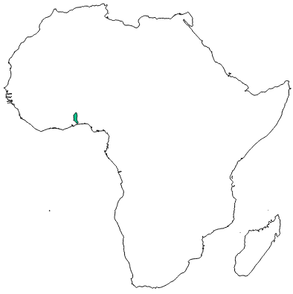
Presentation of the Mono River basin 1/2
West Africa
Lat. : 6˚ 12’N et 9˚ 15’ N
Long. : 00˚ 40’ et 02˚E
A = 23.800 km²
(More than 88% in Togo)
MMQ at Athiémé = 110 m³/s

Slide 5
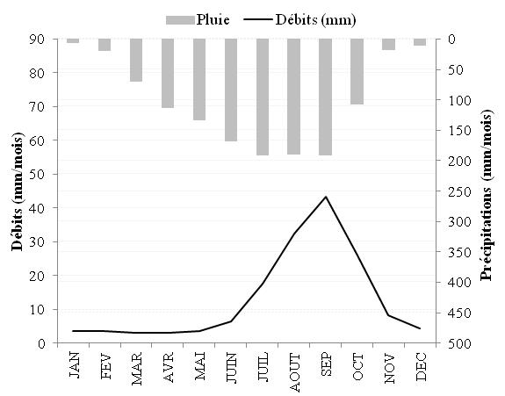
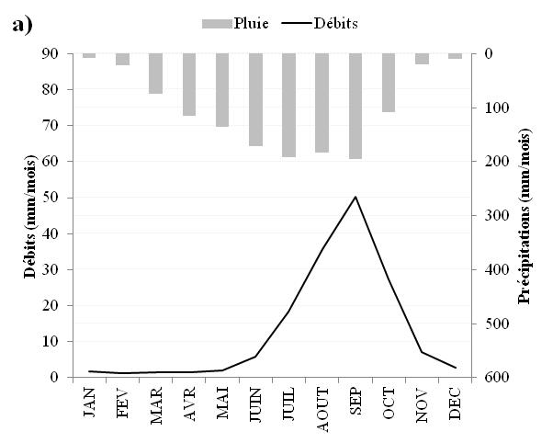
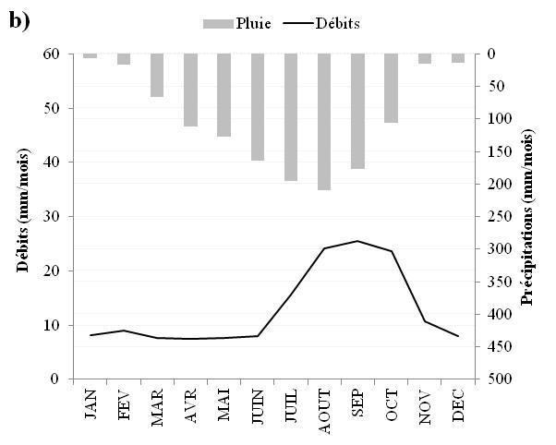
Presentation of the Mono River basin 2/2
Monthly flows at Athieme (1960-2000)
Monthly flows at Athiémé a) before (1960-1987) and after (1987-2000) the operationalization of the Nangbéto hydropower dam

Slide 6
Methodology
Data
TRMM 3B42 (0.25º)
PERSIANN (0.25º)
ERA Interim (0.75º)
Methods
Implementation of CHyM model
Model running under different conditions and on different periods and with different datasets
Visual assessment

Slide 7
Results 1/3
Observed and simulated discharge (June-September 1979)

Slide 8
Results 2/3
Observed and simulated discharge (June-August 1998)

Slide 9
Results 3/3
Observed and simulated discharge (March-November 2010)

Slide 10
Conclusion
CHyM model performance in the Mono River basin is promising
Objective conclusion on the performance of different datasets can not be made
Further work on the model and its calibration is required

Slide 11
THANKS FOR YOUR ATTENTION

